Slide 1

KS3 Mathematics
N1 Place value
Notes:
The aim of this unit is to teach pupils to:
Understand and use decimal notation and place value; multiply and divide integers and decimals by powers of 10.
Compare and order decimals.
Round numbers, including to a given number of decimal places or significant figures.
Material in this unit is linked to the Key Stage 3 Framework supplement of examples pp 36-39.

Slide 2

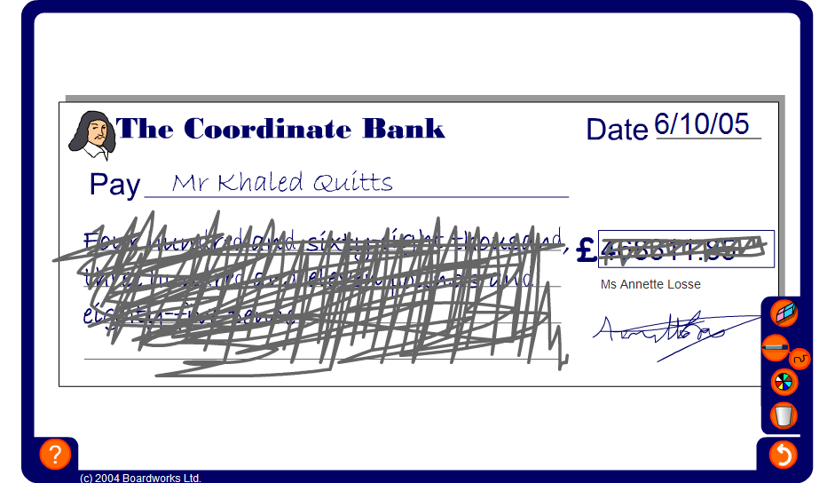


Blank cheques
Notes:
The aim of the activity is to ensure that pupils are able to read large numbers in the context of money.
Ask pupils why they think it is necessary to write amounts of money in words on cheques.
Start by revealing the amount of money on the cheque in figures and asking pupils how it would be written in words. Repeat the activity with the amount of money shown in words and ask pupils how it would be written in figures.
Point out to pupils that in the context of money 302.76 is read as ‘three hundred and two pounds, seventy-six’. If this number were not in the context of money it would be read as ‘three hundred and two point seven six’. When we say ‘seventy-six’ in the context of money we are referring to seventy-six pence. When we say ‘point seven six’ in the context of decimal numbers we are referring to 7 tenths and 6 hundredths.
Also stress that the decimal 4.50 is usually written as 4.5. However, we cannot write £4.5 in the context of money. This must be written as £4.50.
When writing amounts of money we cannot combine units, for example £6.73p is not allowed. This must be written either as £6.73 or as 673p.

Slide 3

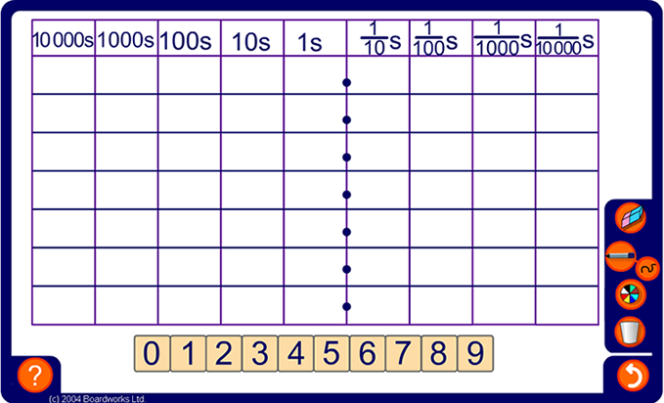
Place value
Notes:
Before starting the activity make sure that pupils can verbally describe the column headings and understand that the place value grid can be extended in both directions.
Describe the decimal point as a means of separating the whole number part of a number from the fractional part.
Start by dragging an example onto the grid, for example 6304.907.
Ask what the 6 is worth in this position (6 thousand), what the 3 is worth in this position (3 hundred), and so on.
Discuss the importance of the zero place holder.
Ask pupils to tell you the most important digit in this number. Establish that this is the 6 because it is worth 6 thousand. Although 9 is a bigger digit, it is only worth 9 tenths. We call 6 the most significant digit.
Ask pupils to add and subtract 0.001, 0.01 then 0.1 from the number. Note that to subtract 0.01 from this number we need to take 1 from the tenths column, then swap the 0 for a 9 to give 6304.897. Compare this with subtracting 10 from 907. Also, since there is a 9 in the tenths column, the effect of adding 0.1 is to add one to the digit in the units column to give 6305.007. Compare this with adding 100 to 4907.
The place value grid can also be used to demonstrate multiplying and dividing numbers by 10, 100, 1000, 0.1 and 0.01. Groups of digits can be dragged to the left and right to show this.

Slide 4
Multiplying by 10, 100 and 1000
What is 6.2 × 10?
Let’s look at what happens on the place value grid.
Thousands
Hundreds
Tens
Units
tenths
hundredths
thousandths
6
2
6
2
When we multiply by ten the digits move one place to the left.
6.2 × 10 = 62
Notes:
This is the first of three slides illustrating the effect of multiplying a decimal number by 10, 100 and 1000.
Start by checking that pupils can multiply whole numbers by 10, 100 and 1000 and divide whole numbers ending in 0, 00 and 000 by 10, 100 and 1000.
Tell pupils that we often need to be able to multiply and divide numbers by 10, 100 and 1000 in every day life, for example when converting between metric units. Give examples as necessary.
Explain that we are now going to look at the effect of multiplying decimals by 10, 100 and 1000.
Look at the question on the slide. Most pupils will be able to solve this without reference to the place value grid.
Reveal each step on the slide and encourage the idea that the digits are moved one place to the left to make the number ten times bigger (rather than the decimal point being moved one place to the right).
Links:
N9 Mental methods – multiplication and division
S7 Measures – converting units

Slide 5
Multiplying by 10, 100 and 1000
What is 3.1 × 100?
Let’s look at what happens on the place value grid.
Thousands
Hundreds
Tens
Units
tenths
hundredths
thousandths
3
1
3
1
0
When we multiply by one hundred the digits move two places to the left.
We then add a zero place holder.
3.1 × 100 = 310
Notes:
Again, stress that it is the digits that are being moved two places to the left and not the decimal point that is being moved two places to the right.

Slide 6
Multiplying by 10, 100 and 1000
What is 0.7 × 1000?
Let’s look at what happens on the place value grid.
Thousands
Hundreds
Tens
Units
tenths
hundredths
thousandths
0
7
7
0
0
When we multiply by one thousand the digits move three places to the left.
We then add zero place holders.
0.7 × 1000 = 700

Slide 7
Dividing by 10, 100 and 1000
What is 4.5 ÷ 10?
Let’s look at what happens on the place value grid.
Thousands
Hundreds
Tens
Units
tenths
hundredths
thousandths
4
5
0
4
5
When we divide by ten the digits move one place to the right.
When we write decimals it is usual to write a zero in the units column when there are no whole numbers.
4.5 ÷ 10 = 0.45
Notes:
The next three slides illustrate the effect of dividing a decimal number by 10, 100 and 1000.
Link:
N9 Mental methods – multiplication and division

Slide 8
Dividing by 10, 100 and 1000
What is 9.4 ÷ 100?
Let’s look at what happens on the place value grid.
Thousands
Hundreds
Tens
Units
tenths
hundredths
thousandths
9
4
0
0
9
4
When we divide by one hundred the digits move two places to the right.
We need to add zero place holders.
9.4 ÷ 100 = 0.094
Notes:
Link:
N9 Mental methods – multiplication and division

Slide 9
Dividing by 10, 100 and 1000
What is 510 ÷ 1000?
Let’s look at what happens on the place value grid.
Thousands
Hundreds
Tens
Units
tenths
hundredths
thousandths
5
1
0
0
5
1
When we divide by one thousand the digits move three places to the right.
We add a zero before the decimal point.
510 ÷ 1000 = 0.51
Notes:
Link:
N9 Mental methods – multiplication and division

Slide 10
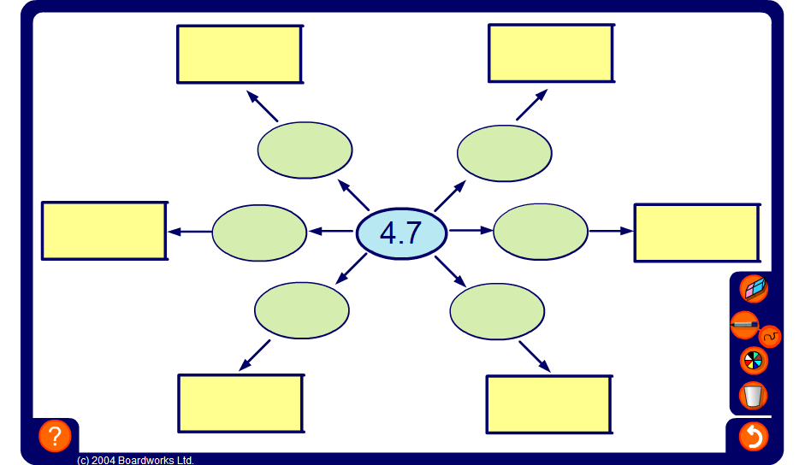
Spider diagram
Notes:
This activity illustrates the effect of multiplying and dividing decimals by 10, 100 and 1000.
Click on the green ovals to reveal the number inside.
Reset the activity to change the central number.

Slide 11
Multiplying and dividing by 10, 100 and 1000
Complete the following:
3.4 × 10 =
34
10
73.8 ÷ = 7.38
64.34 ÷ = 0.6434
100
8310
÷ 1000 = 8.31
1000
× 45.8 = 45 800
1000
0.64 × = 640
43.7 × = 4370
100
0.021 × 100 =
2.1
92.1 ÷ 10 =
9.21
100
250 ÷ = 2.5
Notes:
Complete the exercise as a class.
An alternative would be to erase the answers from the slide (or change the animation order) and ask pupils to complete the exercise individually; you could also give pupils a worksheet with similar calculations.

Slide 12
Multiplying by 0.1 and 0.01
What is 4 × 0.1?
We can think of this as 4 lots of 0.1 or 0.1 + 0.1 + 0.1 + 0.1.
We can also think of this as 4 ×
1
10
1
4 × is equivalent to 4 ÷ 10
10
Therefore,
4 × 0.1 = 0.4
Multiplying by 0.1
is the same as
Dividing by 10
Notes:
There are many ways in which to visualize the multiplication of a whole number by 0.1. Discuss as a group.
Ask pupils what they think 2.7 × 0.1 is, or 32.8 × 0.1.

Slide 13
Multiplying by 0.1 and 0.01
What is 3 × 0.01?
We can think of this as 3 lots of 0.01 or 0.01 + 0.01 + 0.01.
We can also think of this as 3 ×
1
100
1
3 × is equivalent to 3 ÷ 100
100
Therefore,
3 × 0.01 = 0.03
Multiplying by 0.01
is the same as
Dividing by 100
Notes:
Extend the discussion to multiplication by 0.01.

Slide 14
Dividing by 0.1 and 0.01
What is 7 ÷ 0.1?
We can think of this as “How many 0.1s (tenths) are there in 7?”
There are ten 0.1s (tenths) in each whole one.
So, in 7 there are 7 × 10 tenths.
Therefore,
7 ÷ 0.1 = 70
Dividing by 0.1
is the same as
Multiplying by 10
Notes:
Discuss ways to visualize dividing whole numbers by 0.1. Extend to dividing decimals by 0.1.

Slide 15
Dividing by 0.1 and 0.01
What is 12 ÷ 0.01?
We can think of this as “How many 0.01s (hundredths) are there in 12?”
There are a hundred 0.01s (hundredths) in each whole one.
So, in 12 there are 12 × 100 hundredths.
Therefore,
12 ÷ 0.01 = 1200
Dividing by 0.01
is the same as
Multiplying by 100
Notes:
Extend the discussion to dividing by 0.01.

Slide 16
Multiplying and dividing by 0.1 and 0.01
Complete the following:
24 × 0.1 =
2.4
0.01
92.8 ÷ = 9280
52 ÷ = 5200
0.01
0.674
÷ 0.001 = 674
0.01
× 950 = 9.5
0.001
470 × = 0.47
31.2 × = 3.12
830 × 0.01 =
8.3
0.1
6.51 ÷ 0.1 =
65.1
0.54 ÷ = 5.4
0.1
Notes:
Complete the exercise as a class.
An alternative would be to erase the answers from the slide (or change the animation order) and ask pupils to complete the exercise individually; you could also give pupils a worksheet with similar calculations.

Slide 17
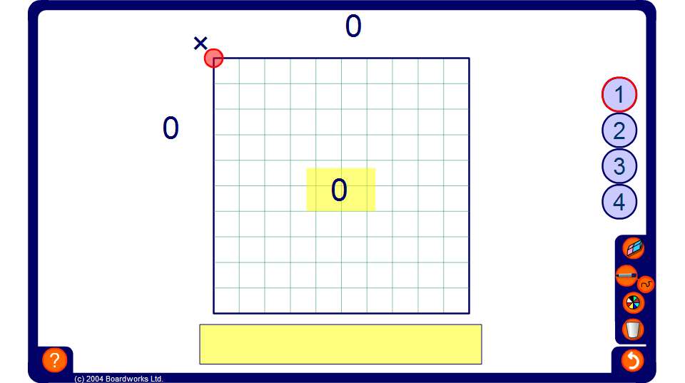
Multiplying by small multiples of 0.1
Notes:
Use this grid to demonstrate the effect of multiplying by 0.1 and small multiples of 0.1.
Start by explaining to pupils that the large square represents one whole. It is one unit across and one unit down. The square is divided into ten equal parts across the top and so each division across the length must be equal to 0.1. The same is true down the side. Establish that the unit square is divided into 100 equal parts and so each small part is one hundredth of the large square or 0.01.
Compare this with the fact that there are 100 mm² in 1 cm².
Demonstrate various calculations by changing the size of the shaded area. For example, start by showing that 0.1 × 0.1 = 0.01. One tenth of the width multiplied by one tenth of the length equals one hundredth of the whole unit.
Ask pupils what 0.2 × 0.4 is equal to. It is a common error to give the answer as 0.8. Show, using the grid that the answer is 0.08.
Change the number of unit squares to extend to more difficult problems. For example, 0.4 × 3.7 is equal to 0.4 × (1 + 1 + 1 + 0.7) = 0.4 + 0.4 + 0.4 + 0.28 = 1.48
Click on the yellow rectangles to hide the answers. An ask pupils to calculate the solutions mentally using the diagram.

